Slide 1
Subject “Web Programming” Dutch Auction PHP Program
Takahiro FUJIWARA – DQ4WX0
2023.06.30.

Slide 2
Introduction
This is just a short program for Dutch Auction Web Page
Created for an exam one day program
Therefore, there are many limitations
Limitations
Business Logic is the main focus point
Designs are the minimum
Extra
Photo handling is added later, +one day programing

Slide 3
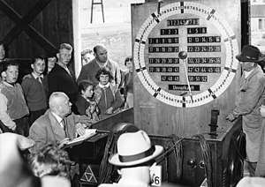
What is Dutch Auction?
One of auctions for buying or selling goods
Most commonly used for goods that are required to be sold quickly such as flowers, fresh produce, or tobacco
A sale never requires more than one bid – quick sale
The auctioneer begins with –
a high asking price for start selling
Make the price lower until –
some participant accepts the price
or it reaches a predetermined reserve price
A 1957 Dutch auction in Germany to sell fruit. – Wikipedia, Dutch auction 2023.06.28.

Slide 4
The Task – One Day Program
Login – with login action
Seller – Register item
Seller – See registered items
Bidder – See all biddable items
Bidder – See my bided items
Seller – Register Item
Register Item name, photo,
Price (highest=start, lowest=end),
Time interval of change price,
Decreasing price for each time interval
Seller – See registered items
List of all items only registered by the user
See the item current price, bid status (not yet, bid done, who bided), photo
Bidder – See all biddable items
List all biddable items from any user
Bid button for each item, see item photo
Bidder – See my bided items
List of all items only bided by the user
See item photo

Slide 5

My Work – 1. Define The Business Logic
MySQL
MySQL
Login
User DB
Item DB
Long BLOB
Item Photo
Button:
Bidder – See all biddable Items
Button:
Seller – See Registered Item
Seller – Register Item
Bidder – Biddable Item List
Item Photo
Register
Button:
Seller – Register item
Button:
Bidder – See my bided Items
Bid
Seller – Item List
Bidder – Bided Item List
Item Photo
Item Photo

Slide 6
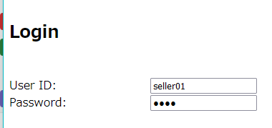
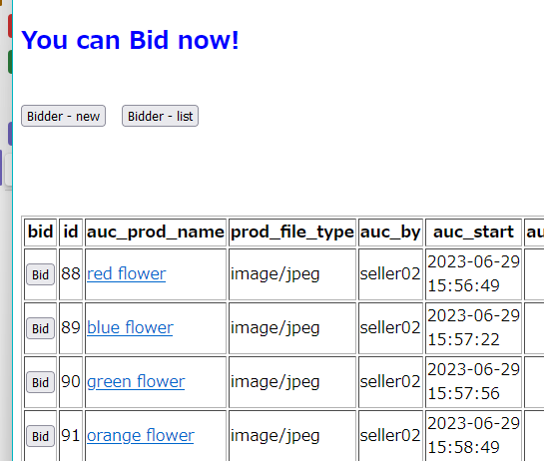
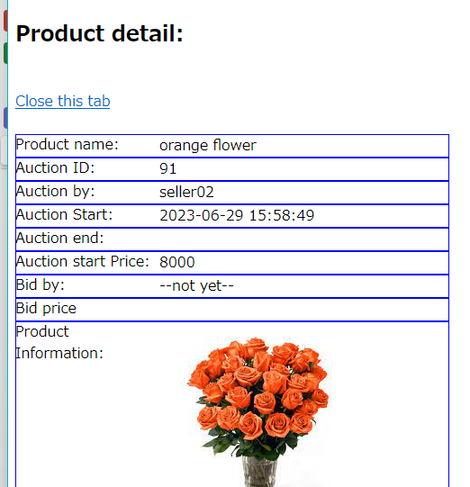
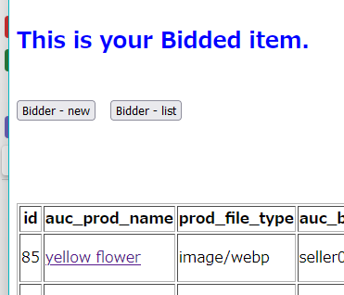
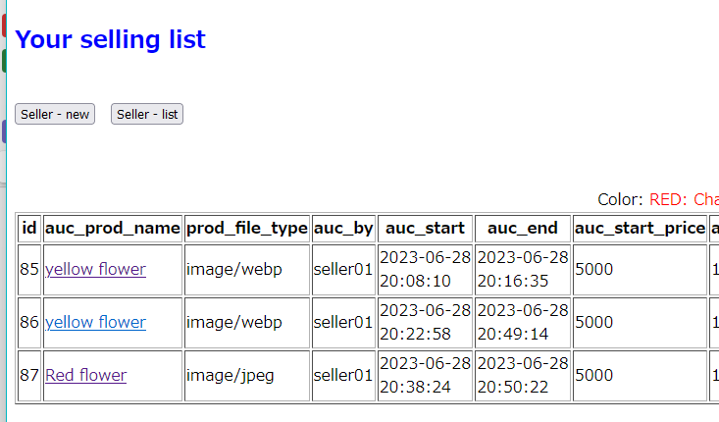
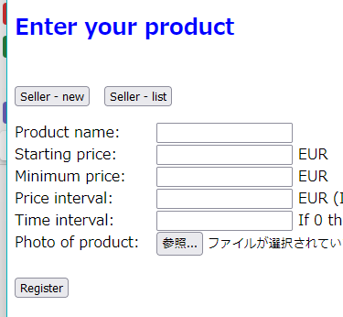
My Work – 2. Design Pages, minimum for one day work
Start
Bidder – Biddable Item List
BI
Login
Photo
Item Photo
SI
Bidder – bided Item List
Seller – Item List
BdI
Seller – Register Item
SR
Start
SI
SR
BI
Photo
BdI
These 6 pages are corresponded to the diagram in next page.

Slide 7
My Work – 3. Design the Logic: Simple and Consistent
Seller Regist
Seller Items
List – for Seller
List – Biddable
List – Bided by bidder
Biddable Items
Bided Items
Common Modules
Show Photo
Start
SR
SI
BI
BdI
List
Photo
Login Credential
Item Registration for Seller
List – for Seller
List – Biddable
List – Bided by bidder
Item DB
user,
bid or not
Item DB LongBLOB
Button
Item DB
Button
Button
Button
Generate List
Show Photo
Seller Regist
SR
Seller Regist
Biddable Items
Biddable Items
SI
SR
BI
BI
Seller Items
SI
Return
Return
Biddable Items
BI
Seller Items
SI
Bided Items
BdI
Bided Items
BdI
Bided Items
BdI

Slide 8
My Work – 4. Coding a PHP Program
Module Name | Lines | PHP file | Remarks
Main Module
Login and misc. | 290 Lines | v2.php | Avoid dual login
Seller – Item Registration | 80 Lines | v2.php | File upload button
Seller – Item List | 20 Lines | v2.php | Limit to the login user
Bidder – Biddable Item List | 50 Lines | v2.php | Direct bid button for each item
Bidder – Bided Item List | 20 Lines | v2.php | Limit to the login user
Common module
Display List | 120 Lines | v2.php | Parameter: User, bid-status
Item Photo | 120 Lines | detail.php, content.php | Support many image files including jpeg, mp4, webp, …
TOTAL | 700 Lines | 3 files

Slide 9
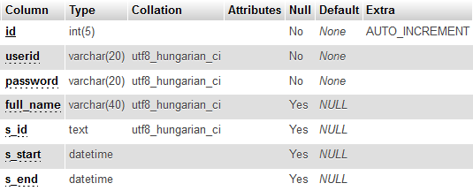
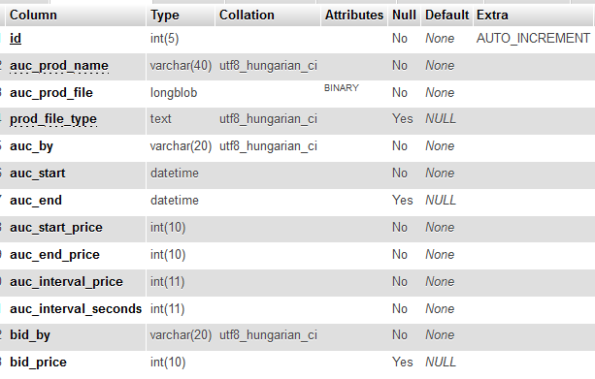
My Work – 5. Database Design
User management
Item management
System Configuration
MySQL Server 5.5.20
Apache Web server +MySQL client 5.5.60
Operated on phpMyAdmin 3.4.11.1

Slide 10
Result video: Behavior of the PHP program

Slide 11
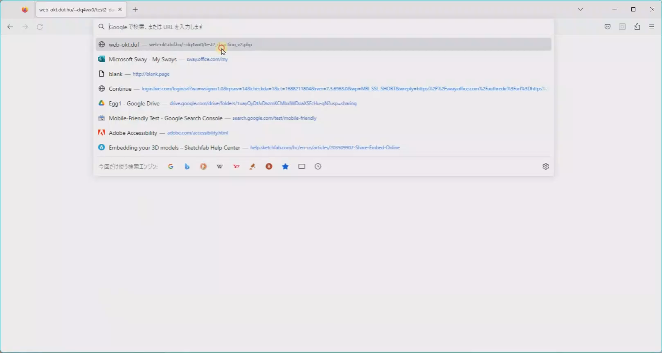
Behavior 1/3: Program Start and Login
Checks for:
Invalid user ID/Password
Dual login for one user in a same time
Video 29sec

Slide 12
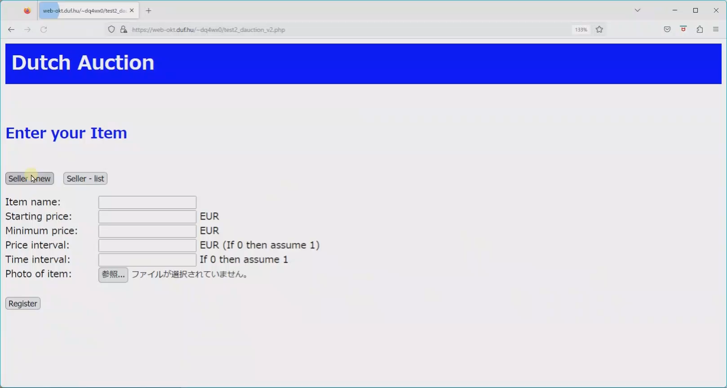
Behavior 2/3: Item Registration and Show It on the List
Item Registration
with photo
List of items
for the user only who registered
Able to see
The Photo
The price is changing
Video 29sec

Slide 13
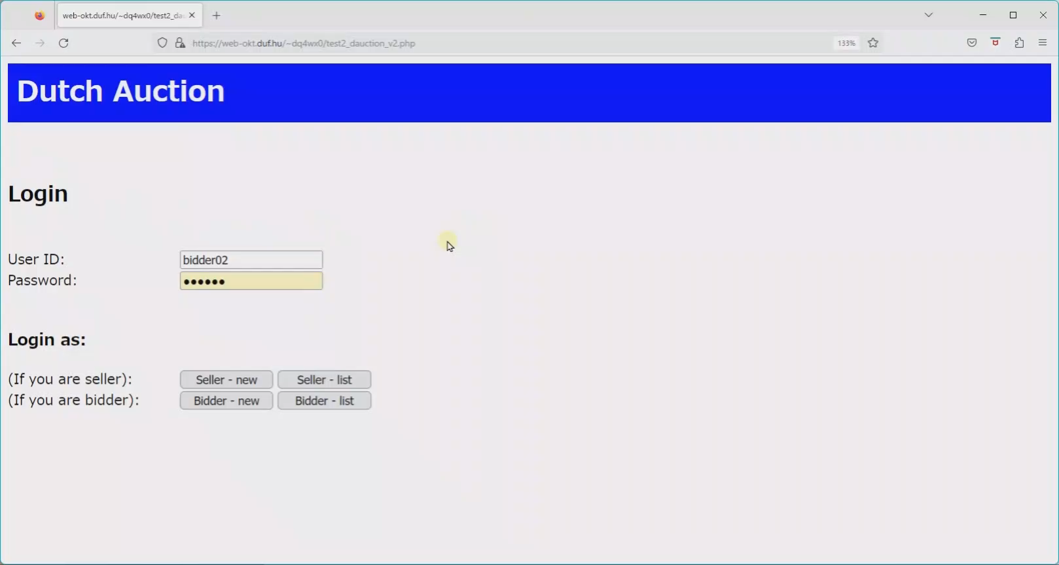
Behavior 3/3: Bidder –Available List and Bid Action
List of all items which able to bid
Regardless the user
Able to see
The price is changing
Detail view with photo
Video 30sec

Slide 14
Closing Remarks

Slide 15
Challenge and the Devised Points
Challenge
Insert Photo image data into database, not as a file
Devised Points
Show the photo image not from a file, but php file with parameter
"echo <img src='photoimage.php?id=".$row['id']."' >";
To avoid complexity, time interval trigger is not used in database
Able to calculate every dynamic price with each different starting price and its interval time

Slide 16
Thanks for your attention
End of Document

